Slide 1
CSE 12 – Basic Data Structures and Object-Oriented Design Lecture 21
Greg Miranda & Paul Cao, Winter 2021
This lecture is being recorded

Slide 2
Announcements
Quiz 21 due Wednesday @ 8am
Survey 9 due Friday @ 11:59pm
PA7 due tomorrow @ 11:59pm (Week 9)

Slide 3
Topics
Heap operations
Heap applications

Slide 4
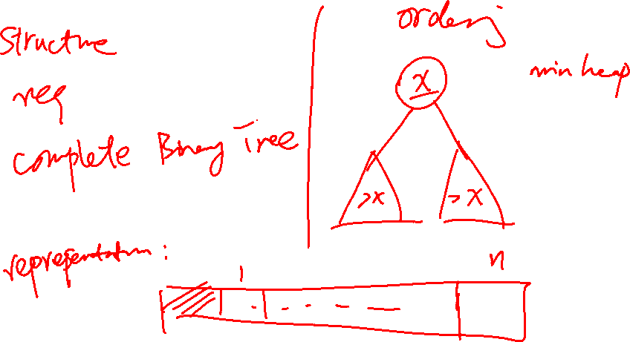
Heap insert and delete

Slide 5

Removing from a heap
When you remove an element from an array-backed heap as we have discussed them, at what index is the element to remove (the one you will return) located? Assume the variable size stores the number of elements currently in the heap, and arr.length is the length of the array storing the heap.
0
1
size – 1
arr.length – 1
You can’t tell with the information given
Notes:
A

Slide 6
Removing from a heap (poll)
5
5
6
10
7
14
11
21
27
18
0 1 2 3 4 5 6 7 8 9
6
10
size
9
7
14
11
21
27
18

Slide 7
Removing from a heap
5
5
6
10
7
14
11
21
27
18
0 1 2 3 4 5 6 7 8 9
6
10
size
9
7
14
11
21
27
18
theHeap[1] = theHeap[size];
NOTE: The assignment uses ArrayLists not arrays

Slide 8
Removing from a heap
18
18
6
10
7
14
11
21
27
18
0 1 2 3 4 5 6 7 8 9
6
10
size
8
7
14
11
21
theHeap[1] = theHeap[size];
size--;
trickleDown( ____?____ );
27
Now 18 needs to trickle down… this should be a separate method. Can be iterative or recursive, but recursive is easier, really!

Slide 9
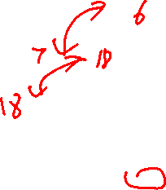
TrickleDown (min heap)
This is the main challenge of writing the heap, so I am not going to write it for you. But I will give you some hints and the general idea behind a recursive approach.
18
18
6
10
7
14
11
21
27
18
0 1 2 3 4 5 6 7 8 9
6
10
size
8
7
14
11
21
27
When we trickle 18 down, which value should become the root?
6
10
27
18 should stay there
Other
Notes:
A

Slide 10

TrickleDown (min heap)
This is the main challenge of writing the heap, so I am not going to write it for you. But I will give you some hints and the general idea behind a recursive approach.
18
size
8
18
6
10
7
14
11
21
27
18
6
10
0 1 2 3 4 5 6 7 8 9
Assume the node to be trickled down is at index and that its left and right children are at lInd and rInd, respectively. Also assume the node at index has two children. Which line correctly completes the code below?
7
14
11
21
27
if ( __________________ ) childInd = lInd;
else childInd = rInd;
swap( theHeap, childInd, index );//only swap if child > parent
lInd < rInd
lInd < index
theHeap[lInd] < theHeap[rInd]
theHeap[lInd] < theHeap[index]
Notes:
D

Slide 11

TrickleDown (min heap)
This is the main challenge of writing the heap, so I am not going to write it for you. But I will give you some hints and the general idea behind a recursive approach.
18
18
6
10
7
14
11
21
27
18
0 1 2 3 4 5 6 7 8 9
6
10
size
8
7
14
11
21
27
There are two base cases for this method. Which of these is one?
18 is in a leaf node
18 is in a node with one child
18 is a node with 2 children
18 is at the root of the heap
Notes:
A

Slide 12

TrickleDown (min heap)
This is the main challenge of writing the heap, so I am not going to write it for you. But I will give you some hints and the general idea behind a recursive approach.
18
18
6
10
7
14
11
21
27
18
0 1 2 3 4 5 6 7 8 9
6
10
size
8
7
14
11
21
27
There are two base cases for this method. Which of these is another?
18 has no children less than itself
18 has no more than one child less than itself.
18 has exactly one child, which is greater than or equal to it
Notes:
A

Slide 13
TrickleDown (min heap)
Here’s a rough recursive algorithm for trickleDown. It’s up to you to translate this to code! And careful, because there are subtleties not mentioned here (e.g., what if the node has only one child?
18
18
6
10
7
14
11
21
27
18
0 1 2 3 4 5 6 7 8 9
6
10
size
8
7
14
11
21
27
trickeDown( index ) // You might need more arguments
If value at index is a leaf, return
If value at index has no children less than it, return
Swap value at index with its smaller child (at childInd)
trickleDown( childInd )

Slide 14
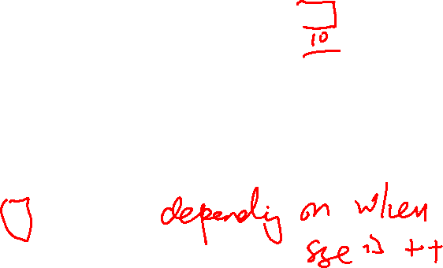
Adding to a heap (offer)
5
5
6
10
7
14
11
21
27
18
0 1 2 3 4 5 6 7 8 9
6
10
size
9
7
14
11
21
27
18
When you add an element to a heap, at what index do you put it initially?
0
size – 1
size
Somewhere else
Notes:
D

Slide 15
Adding to a heap (offer)
5
5
6
10
7
14
11
21
27
18
6
0 1 2 3 4 5 6 7 8 9 10
6
10
size
10
7
14
11
21
27
18
6

Slide 16
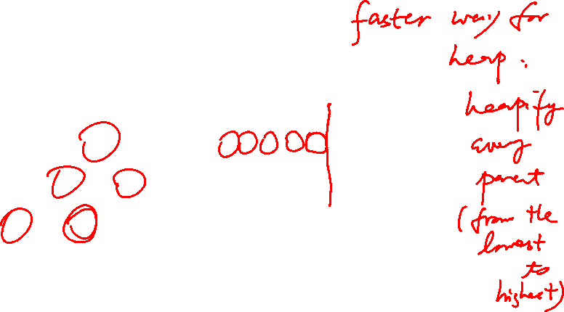
BubbleUp
For offer, you will need a helper method called BubbleUp. we also suggest recursion, and here’s a very rough recursive algorithm, though it’s up to you to figure out the base case.
5
5
6
10
7
14
11
21
27
18
6
0 1 2 3 4 5 6 7 8 9 10
6
10
size
10
7
14
11
21
27
18
6
bubbleUp( index ) // You might need more arguments
If value at index shouldn’t move any more, return
Swap value at index with its parent (at parentInd)
bubbleUp( parentInd )
This is the base case for you to figure out. HINT: There will be more than one

Slide 17
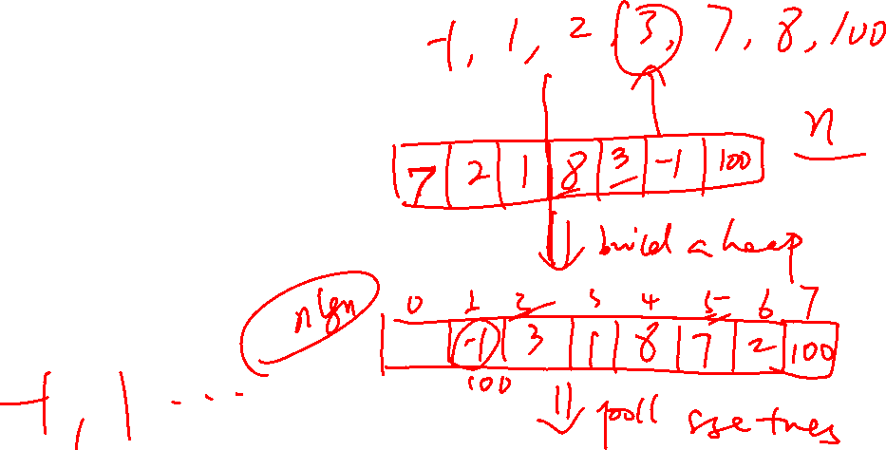
Application of heap
Median tracker
heap sort

Slide 18
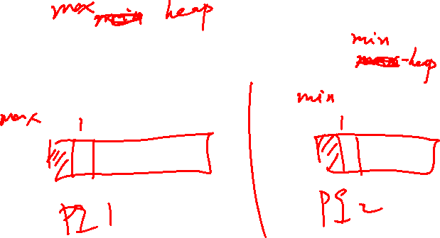
class Tracker {
PriorityQueue<Integer> pq1 = new PriorityQueue<>(Collections.reverseOrder(Integer::compare));
PriorityQueue<Integer> pq2 = new PriorityQueue<>(Integer::compare);
void add(int n) {
if(pq2.size() == 0 && pq1.size() == 0) {
pq2.add(n);
return;
}
int current = get();
if(n >= current) {
pq2.add(n);
}
else {
pq1.add(n);
}
int sizeDifference = pq2.size() - pq1.size();
if(sizeDifference > 1) { pq1.add(pq2.poll()); }
else if(sizeDifference < -1) { pq2.add(pq1.poll()); }
}
}

Slide 19

class Tracker {
PriorityQueue<Integer> pq1 = new PriorityQueue<>(Collections.reverseOrder(Integer::compare));
PriorityQueue<Integer> pq2 = new PriorityQueue<>(Integer::compare);
void add(int n) {
if(pq2.size() == 0 && pq1.size() == 0) {
pq2.add(n);
return;
}
int current = get();
if(n >= current) {
pq2.add(n);
}
else {
pq1.add(n);
}
int sizeDifference = pq2.size() - pq1.size();
if(sizeDifference > 1) { pq1.add(pq2.poll()); }
else if(sizeDifference < -1) { pq2.add(pq1.poll()); }
}
}
int get() {
if(pq2.size() == pq1.size()) { return (pq2.peek() + pq1.peek()) / 2; }
if(pq2.size() > pq1.size()) { return pq2.peek(); }
else { return pq1.peek(); }
}
public String toString() {
return "" + pq1 + " " + this.get() + " " + pq2;
}

Slide 20

MedianTracker (draw the picture and arrays)
Draw the picture and the arrays for the following:
Add the following elements to the MedianTracker (in this order):
5, 10, 15, 20, 25, 30, 35
What is the result of the call to get() after adding all the elements?

Slide 21
Questions on Lecture 21?

